Slide 1
Game Prompting

Slide 2
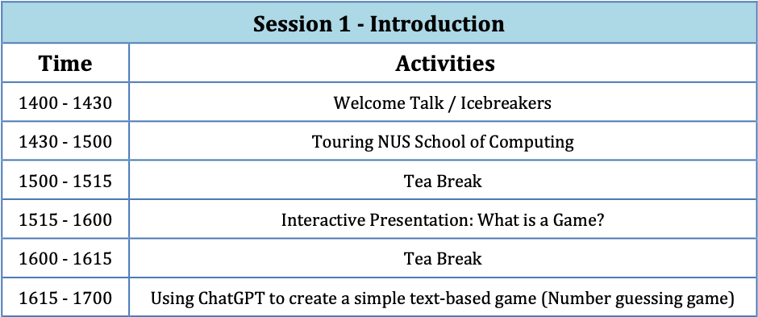
Session 1

Slide 3
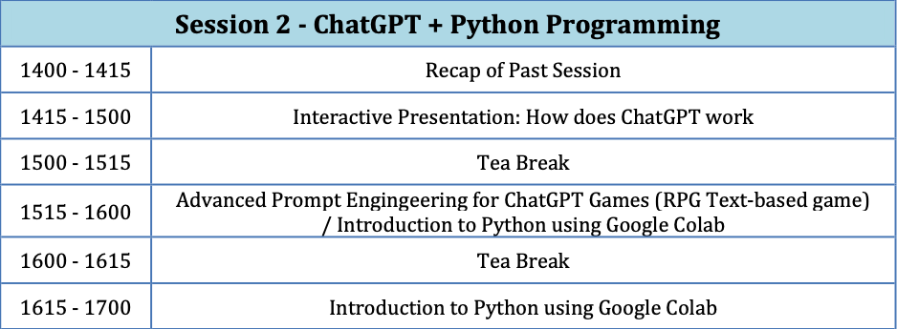
Session 2

Slide 4
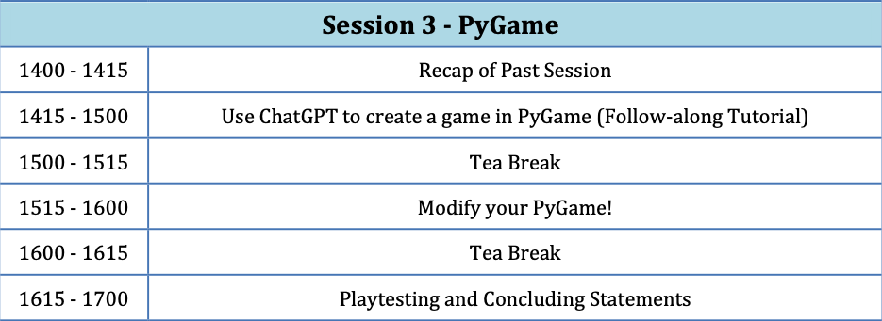
Session 3

Slide 5
Objectives
Impart real-life skills of ChatGPT prompting and basic Python coding
Encourage creativity and hands-on learning by making game ideas come to life

Slide 6
Task
Create a game via ChatGPT that is a single-player game and interacts with the ChatGPT interface
Game should be a turn-based game
Make it fun and be creative
Mini-sharing session at the end to see who’s game is the best

Slide 7
How ChatGPT works (basic)
Twinkle Twinkle Little ______

Slide 8
How ChatGPT works (basic)
Twinkle Twinkle Little ______
Generates next token/words based on earlier token/words
Can go up to 8000 tokens (~6000 words)
Can do conversational style generation between user and AI

Slide 9
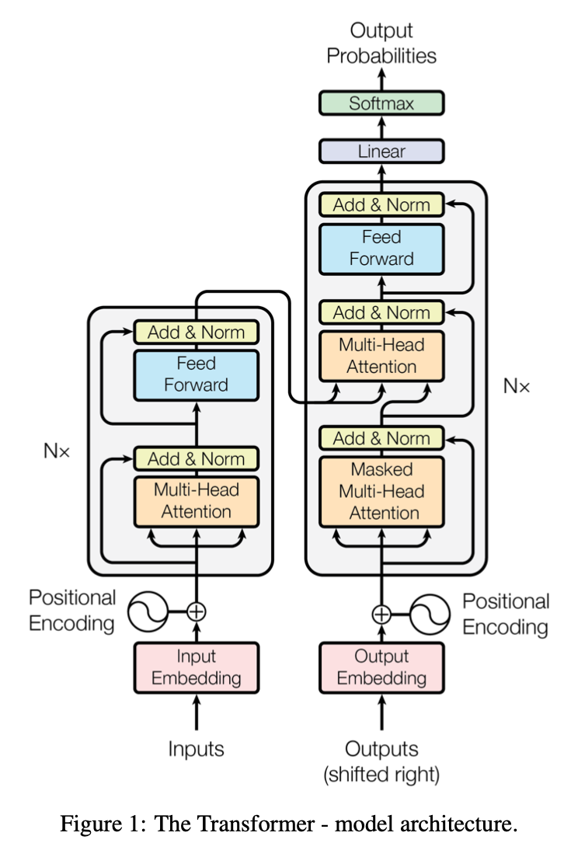
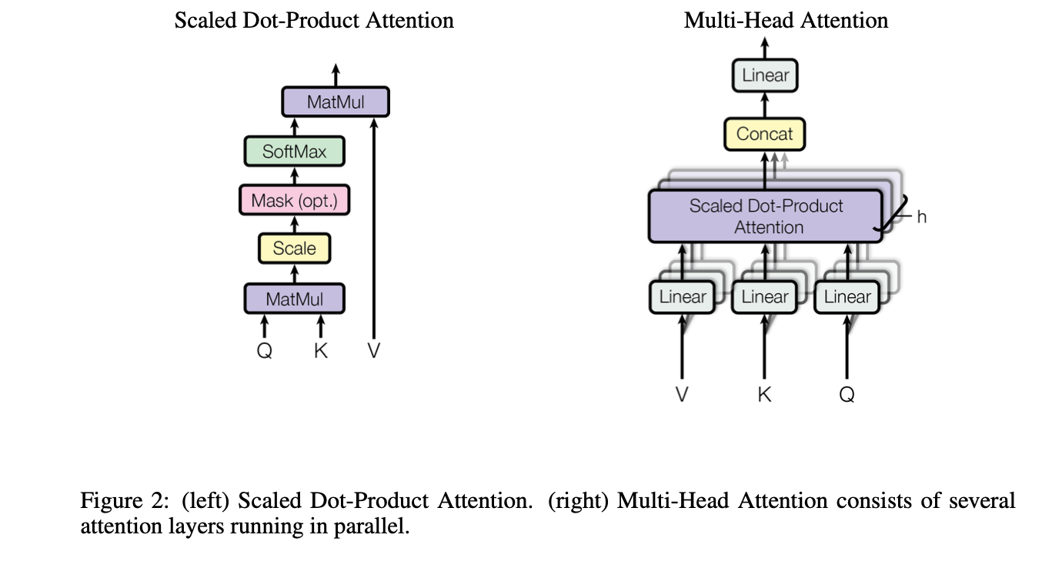

Stuff you can learn if you are interested
Taken from: Attention is all you need. Vaswani et al. (2017)

Slide 10
What to look out for
What prompts work?
What prompts do not work?
How good is ChatGPT’s memory?
Is the output consistent with what you imagine it to be? Why do you think so?

Slide 11
Basic Format
You are a {purpose in life}.
The rules of the game are: {rules}
(Optional) The input-output format is: {format}
The game-win criteria is: {win criteria}
Example
You are a tic tac toe game host.
The board is a 3x3 board, and players alternate between O and X. You are to take the role of O, and the player will take the role of X. Play starts with O.
At the player's turn, you are to display the current board and prompt the player for an input. The game ends if there is no valid move left or if there is a 3-in-a-row.

Slide 12
Example 1
You are a tic tac toe game host.
The board is a 3x3 board, and players alternate between O and X. You are to take the role of O, and the player will take the role of X. Play starts with O.
At the player's turn, you are to display the current board and prompt the player for an input. The game ends if there is no valid move left or if there is a 3-in-a-row.

Slide 13
Example 2
You are a number guessing game host.
You are to think of a number from 1 to 100, and prompt the player to guess the number.
After each guess, you are to say if the secret number is higher or lower than the guess and provide the player with the updated range to guess from.

Slide 14
Example 3
You are a hangman game host.
You are to think of a random word, this word must be a valid word, and prompt the player to guess a letter.
After each guess, you are to say if the letter is found in the word, and display the word with all the guessed letters only. Once the player guesses the entire word fully, the game ends.

Slide 15
Get cracking!

